Slide 1
Introducing
Music provided courtesy of www.bendsound.com

Slide 2
You’ve Started Your Own Business…

Slide 3
Success!!

Slide 4
Employees…

Slide 5
People Problems…

Slide 6
You Need Good HR… at the right price…

Slide 8
Vision…
Do it right… right from the start!

Slide 9
Policies, procedures, and practices define culture!
Benefits
Vacation
Perks
Company Parties
401k
Holidays
Sick Leave

Slide 10
Guidance, when you need it…

Slide 11
… at a predictable cost.
(Hourly options available.)

Slide 12
Contact Us Today!
Tony Benjamin, MBA, PHR
Founder
M: (435) 817-7695
Email: tony@thegrangellc.com
www.thegrangellc.com > Contact US

Slide 13
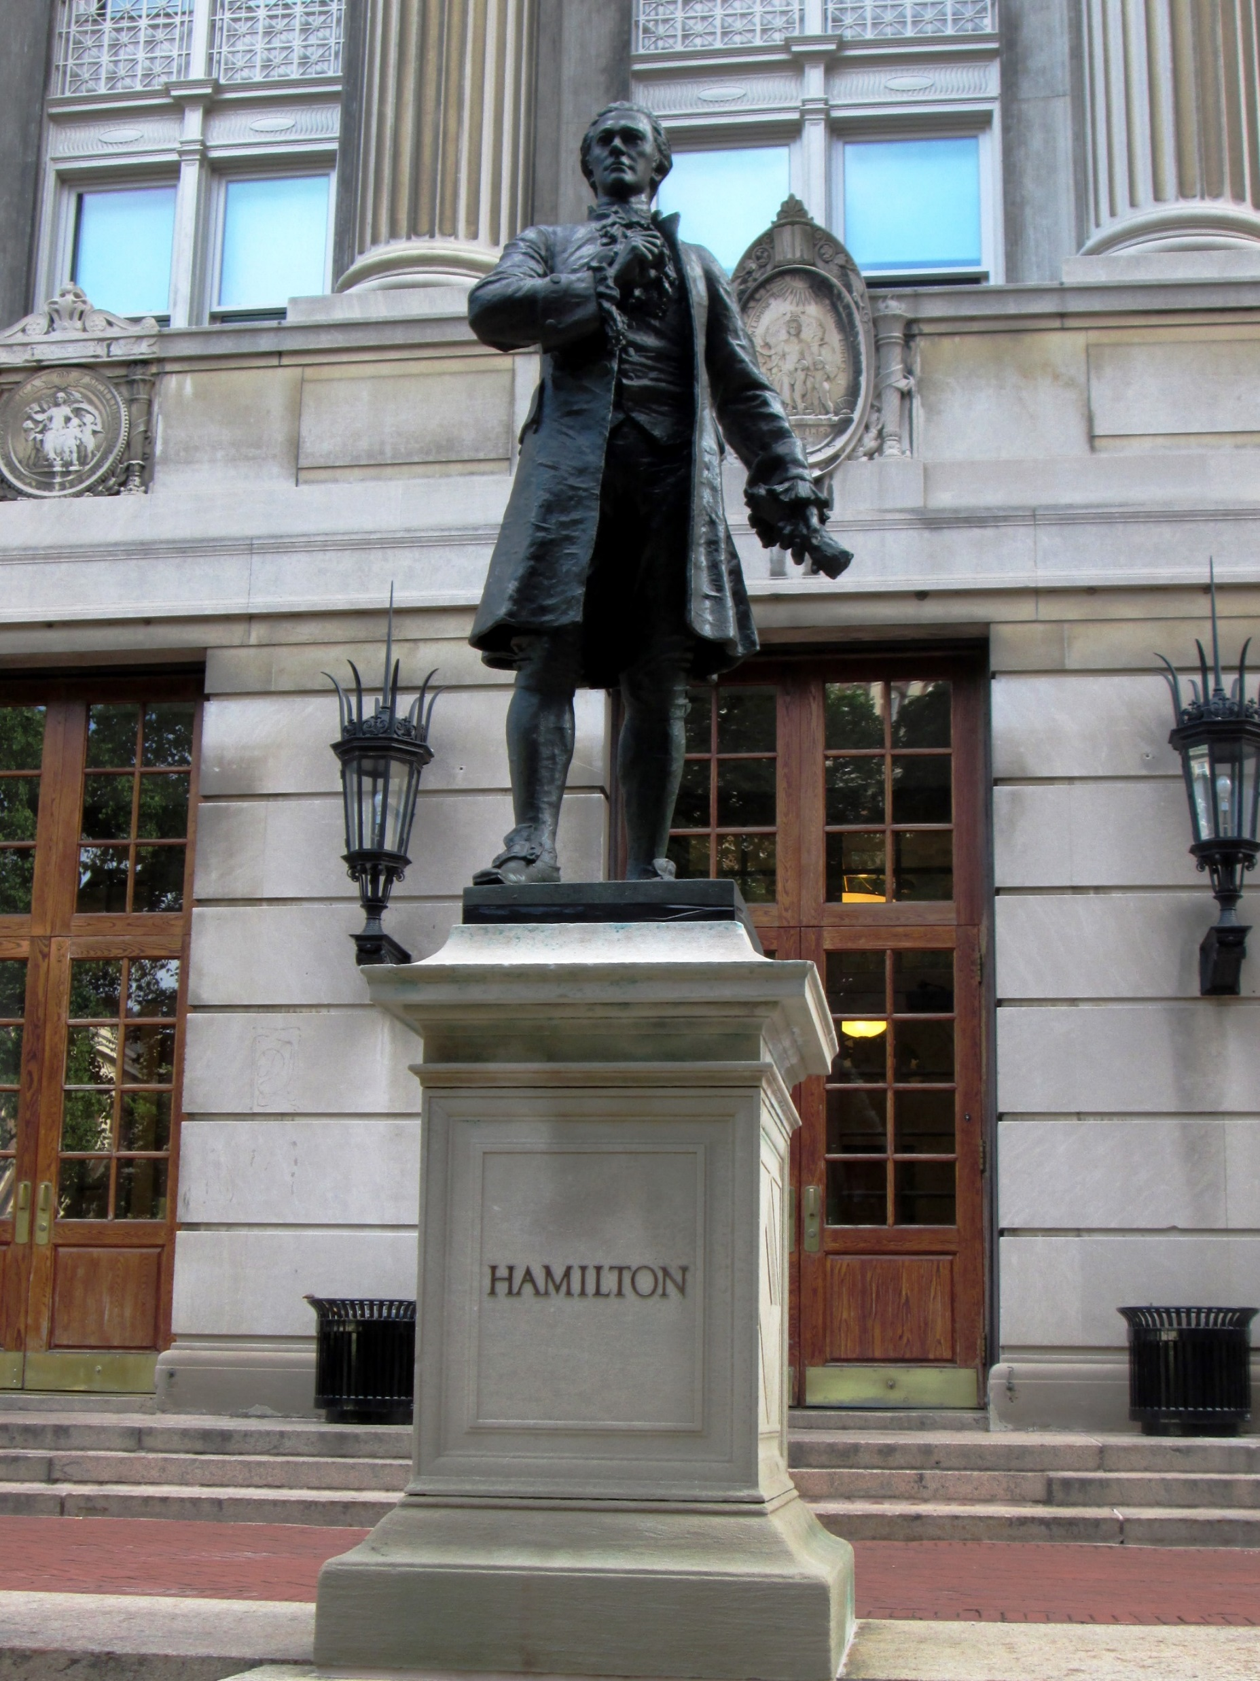
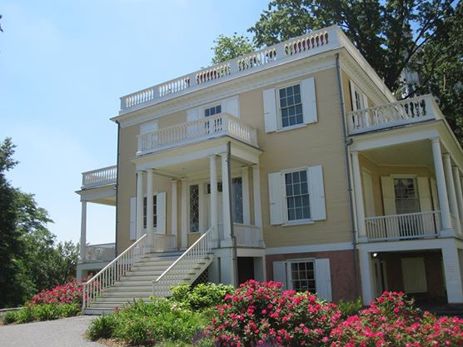
PS… Why “The Grange?”
The Grange was the name Alexander Hamilton gave to his estate. It was his refuge from the storm, a shield against the politics of his day, and a place where he could find answers.
We’ve always admired Hamilton and his world changing ideas. From an illegitimate boy in the Caribbean with no prospects, to founding father of the United States, co-author of the Federalist Papers, and the person credited with inventing modern monetary policies used world wide, Hamilton was a success.
We hold ourselves to that inspirational standard. Come join us in The Grange, a place where you can find answers.

